Slide 1


Development of a grain growth model for U₃Si₂ using experimental data, phase field simulation and molecular dynamics
Yuqing Huang
NE 591

Slide 2

Grain growth
Assuming the only driving force is curvature and there is no significant resistive pressure.
$$D^{n}−D_{0}^{n}=Kt$$
K = $2α\overline{M}\overline{γ}$
$D$ is average grain size
K is kinetic parameter
$α$ is geometric constant
$\overline{M}$ is average grain boundary mobility
$\overline{γ}$ is average grain boundary energy

Slide 3
Cataloge
Determination of the average grain boundary energy
Determination of the kinetic parameter
Determination of the mobility

Slide 4
Determination of the average grain boundary energy

Slide 5
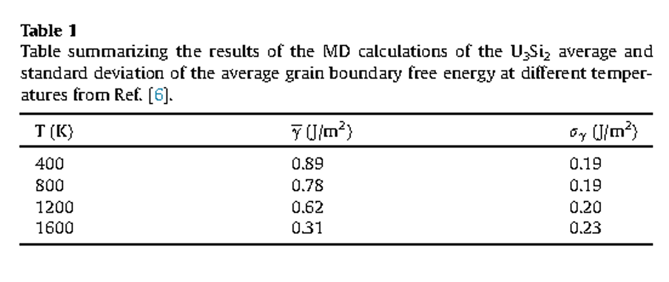
Determination of the average grain boundary energy
Average grain boundary energy is obtained from existing molecular dynamics data

Slide 6
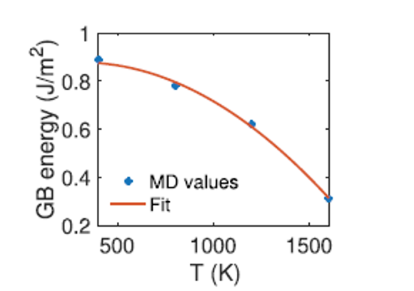

Determination of the average grain boundary energy
The average grain boundary energy results from the sum of the enthalpy of formation per unit area and entropy of formation per unit area
$$\overline{γ}(T)=H(T)−TS(T)$$
$$H(T)=1.21×{10}^{−7}T^{2}−3.46×{10}^{−5}T+0.85J/m^{2}$$
$$S(T)=4.58×{10}^{−7}T−1.72×{10}^{−4}J/m^{2}K$$

Slide 7
Determination of the kinetic parameter

Slide 8

Determination of the kinetic parameter
Kinetic parameter follows an Arrhenius expression
$$K=K_{0}e^{−\frac{Q}{k_{b}T}}$$
$K_{0}$ is prefactor
Q is activation energy

Slide 9
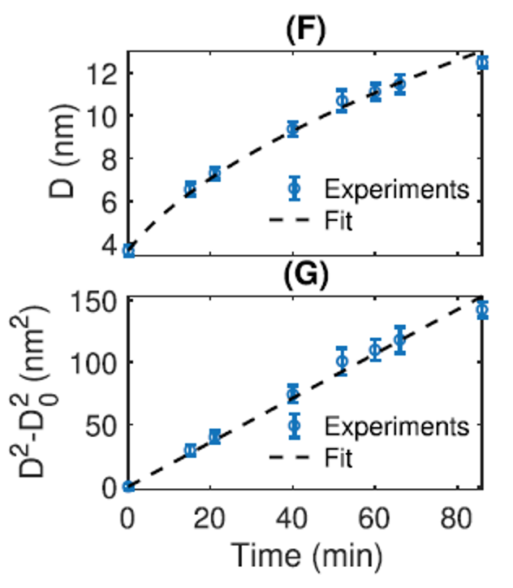
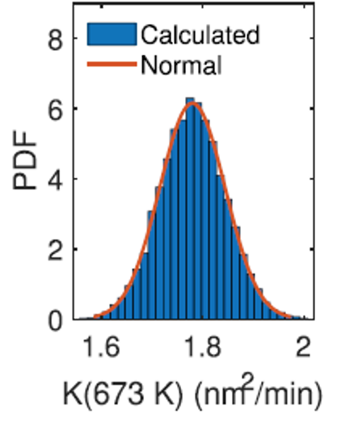

Determination of the kinetic parameter
Isothermal annealing was carried out at one lamella(U₃Si₂) at 673K to measure the average grain size at 8 times to up to 86 min and then obtain the kinetic parameter at 673K by equation below.
$$D^{2}−D_{0}^{2}=Kt$$
$$K\left(673K\right)=2.97±0.11×{10}^{−20}m^{2}/s$$

Slide 10
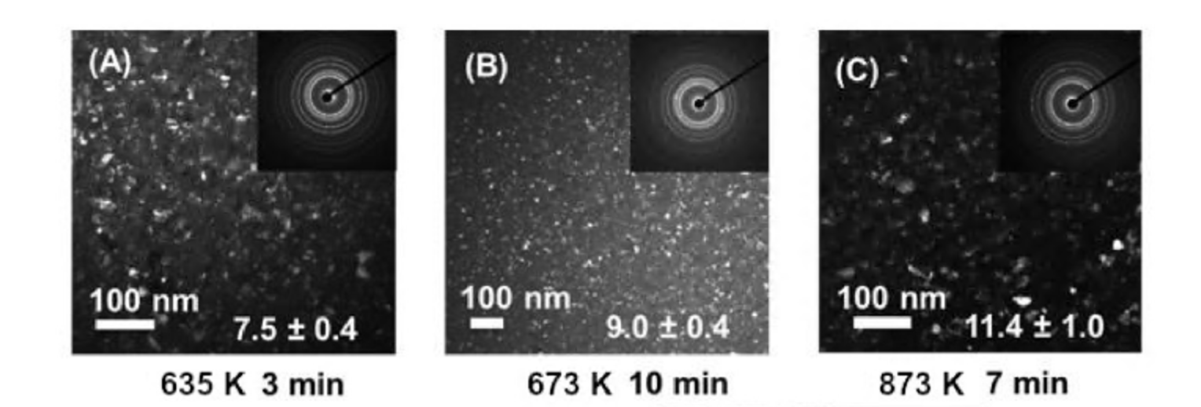
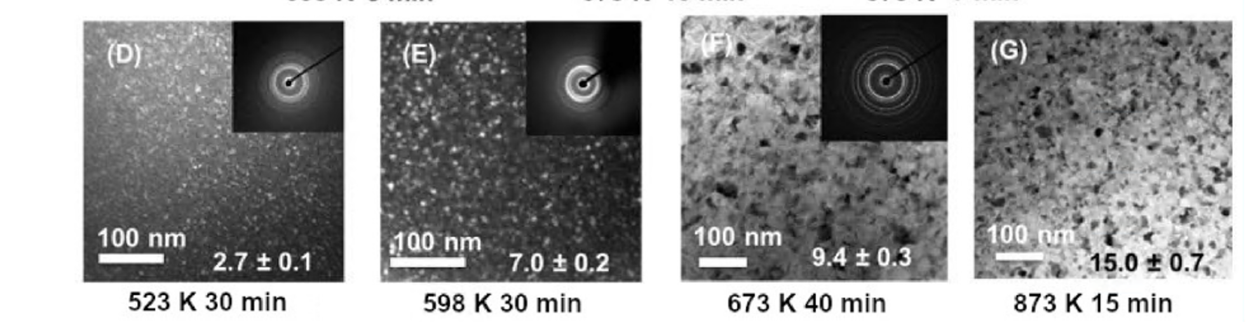
Determination of the kinetic parameter
Other two samples of lamella(U₃Si₂) were annealed at a given temperature until it crystallized and initial image was taken
The sampled was heated and maintained at that temperature for a set amount of time to allow some grain growth, before taking another image.

Slide 11
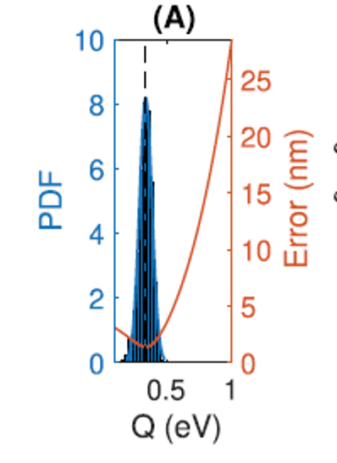

Determination of the kinetic parameter
Varying the values of activation energy to obtain $K_{0}$
$$K_{0}=K(637K)e^{\frac{Q}{k_{b}673.15}}$$
With determined $K_{0}$ and Q to obtain average grain size
$$K=K_{0}e^{−\frac{Q}{k_{b}T}}$$
$$D^{2}−D_{0}^{2}=Kt$$
The minimum error was found to occur when Q = 0.33 eV and then $K_{0}=8.77×{10}^{−18}m^{2}/s$
$$K=8.77×{10}^{−18}e^{−\frac{0.33}{k_{b}T}}m^{2}/s$$

Slide 12
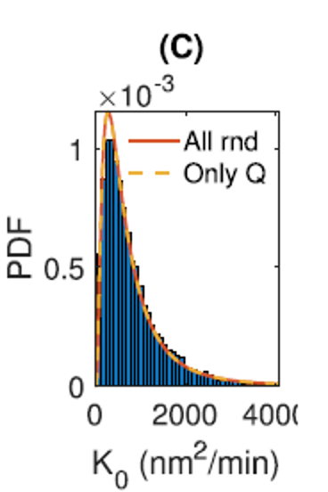
Uncertainty

Slide 13
Determination of the mobility

Slide 14
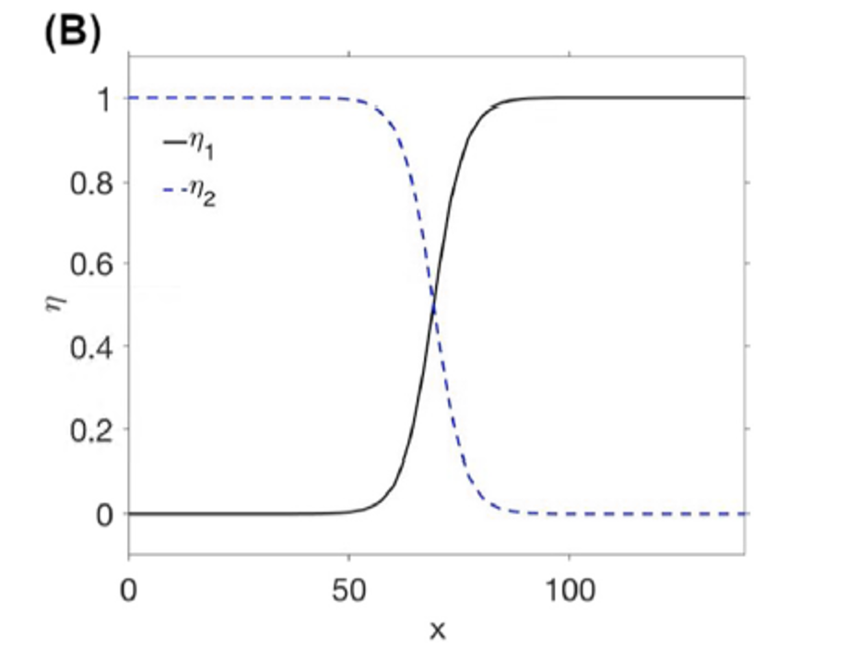

The phase field model
The phase field grain growth model uses phase field variables $η_{j}$to describe grain

Slide 15

The phase field model
The evolution of these variables depends on the change in Gibbs free energy
$$\frac{∂η_{j}}{∂t}=−L_{j}\frac{δF}{δη_{j}}$$
Where $L_{j}$ is the phase mobility
$$F=\int_{V}{\left[mf_{loc}\left(η_{1},…,η_{p}\right)+\frac{k}{2}\sum_{i=1}^{p}{{\left(∇η_{i}\right)}^{2}}\right]dV}$$
Where m is scalar multiplier, K is gradient energy coefficient
$f_{loc}=\sum_{i}^{N}{(\frac{η_{i}^{4}}{4}−\frac{η_{i}^{2}}{2})}+\frac{3}{2}\sum_{i=1}^{N}{\sum_{j>i}^{N}{η_{i}^{2}}}η_{j}^{2}+\frac{1}{4}$

Slide 16
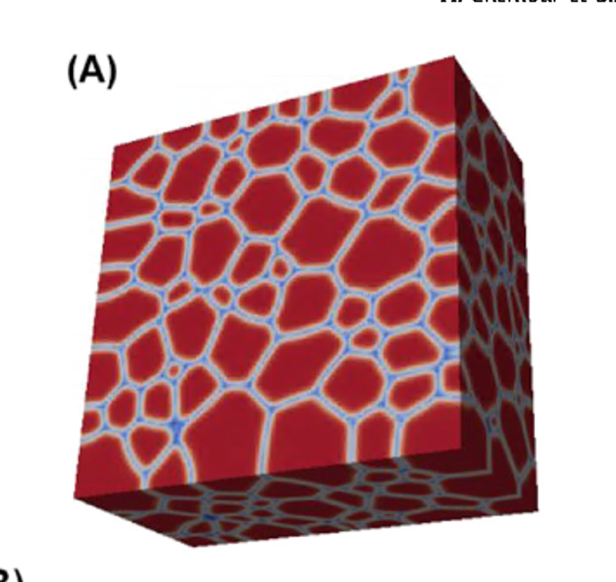

Simulation details
Domain size: $150×150×80 nm$
Initial number of grains: between 500 and 600
Algorithm: Grain Tracker Algorithm
Boundary: zero flux condition
Boundary width: 3nm
Element size: $4{nm}^{3}$to $2083{nm}^{3}$
Time steps: 100 s ~ 1600s
Temperature: 673K
Mobility: $1.78×{10}^{−20}m^{4}/(Js)$

Slide 17

Determination of shape factor
For each different initial grain configuration
$$A_{grain}=\frac{A_{top}}{n_{grain}}$$
$$D^{2}=\frac{4A_{grain}}{π}$$
$$K=\frac{\left(D^{2}−D_{0}^{2}\right)}{t}$$
$$α=\frac{K_{sim}}{2M_{sim}γ_{sim}}$$

Slide 18
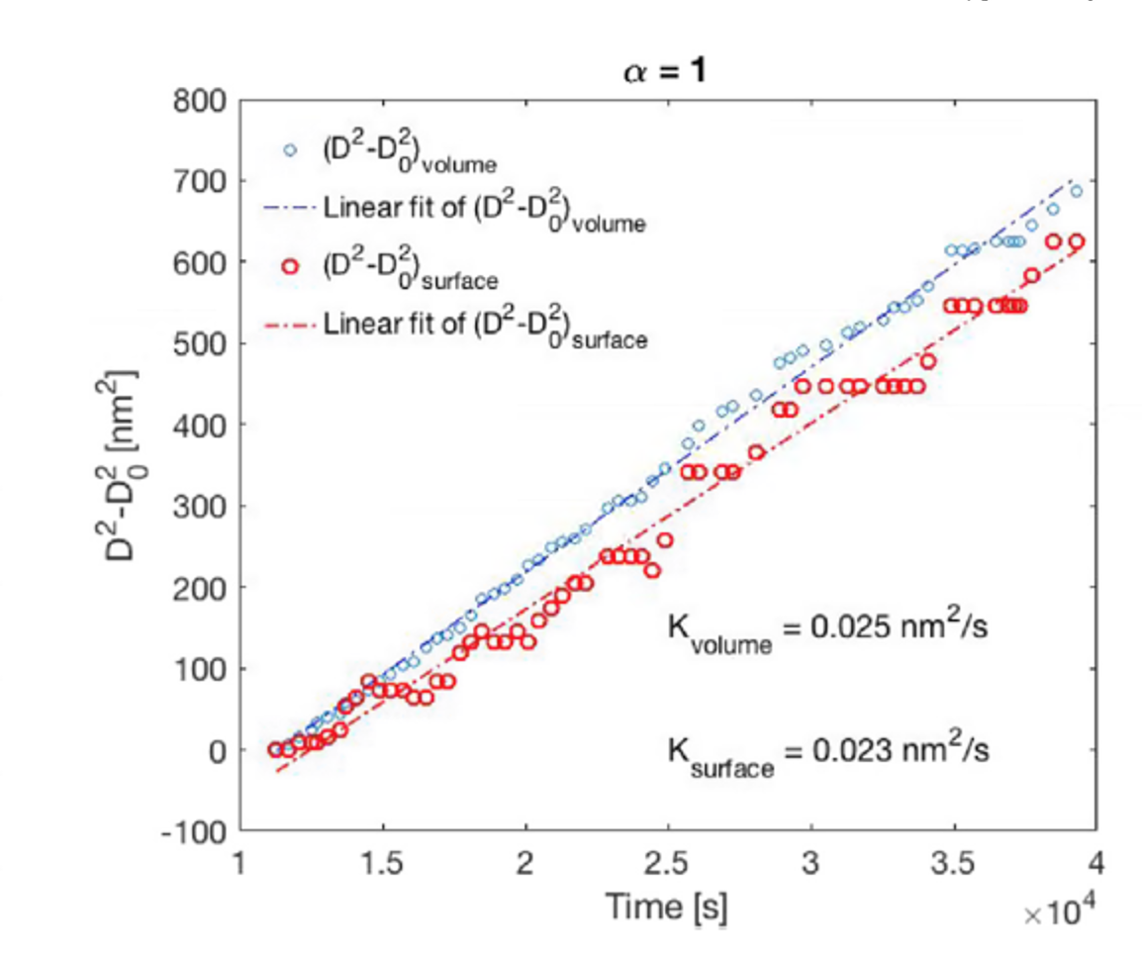
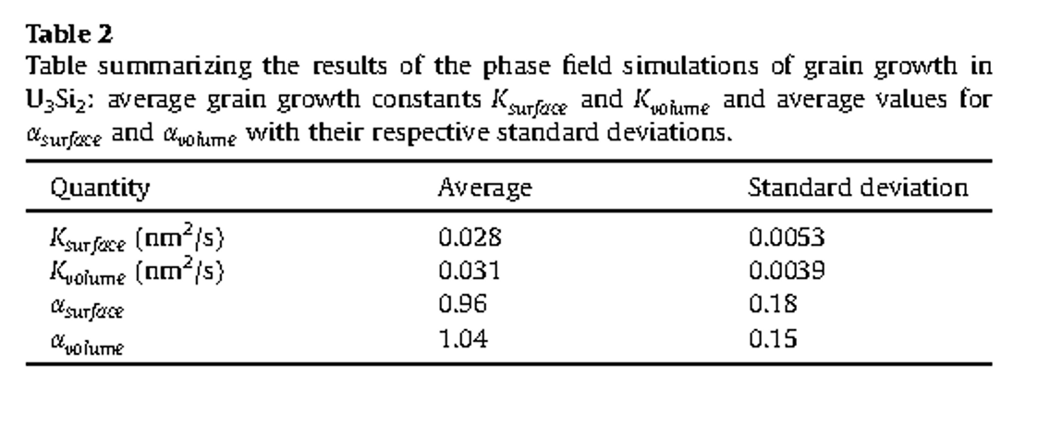
Comparison surface data and volume data

Slide 19

Determination of the grain boundary mobility
The average mobility can be expressed as an Arrhenius expression
$$\overline{M}=M_{0}e^{−\frac{Q}{k_{b}T}}$$
$$M_{0}=\frac{K(673K)}{2α\overline{γ}(673K)}e^{−\frac{Q}{k_{b}673.15}}=6.30×{10}^{−18}m^{4}/(Js)$$
$$\overline{M}=6.30×{10}^{−18}e^{−\frac{0.33eV}{k_{b}T}}$$

Slide 20
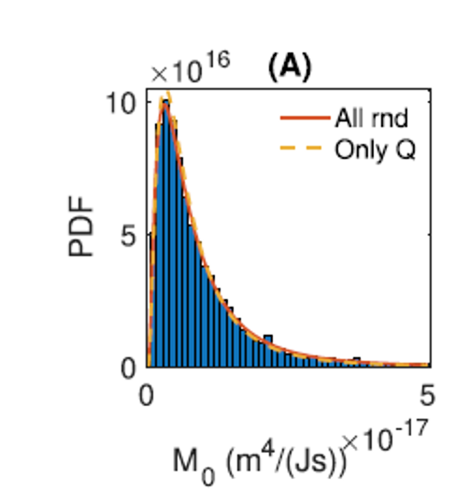
Uncertainty

Slide 21
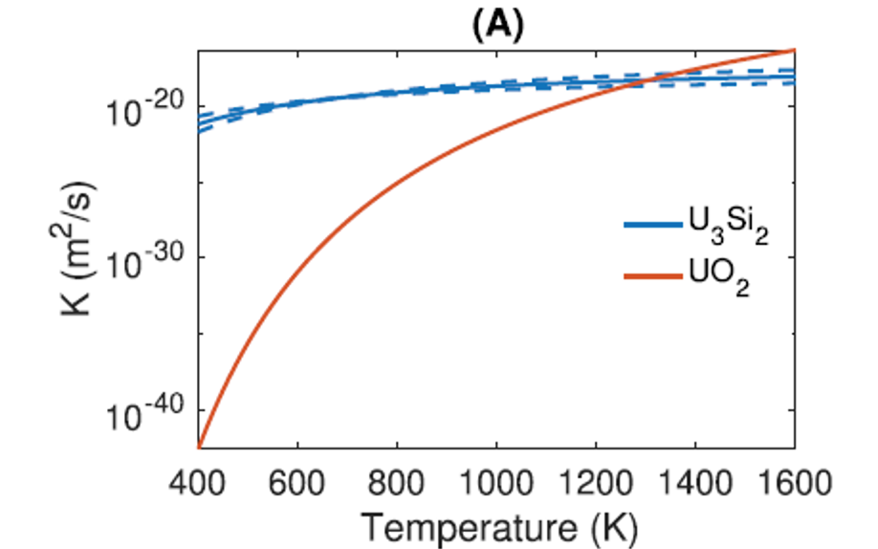
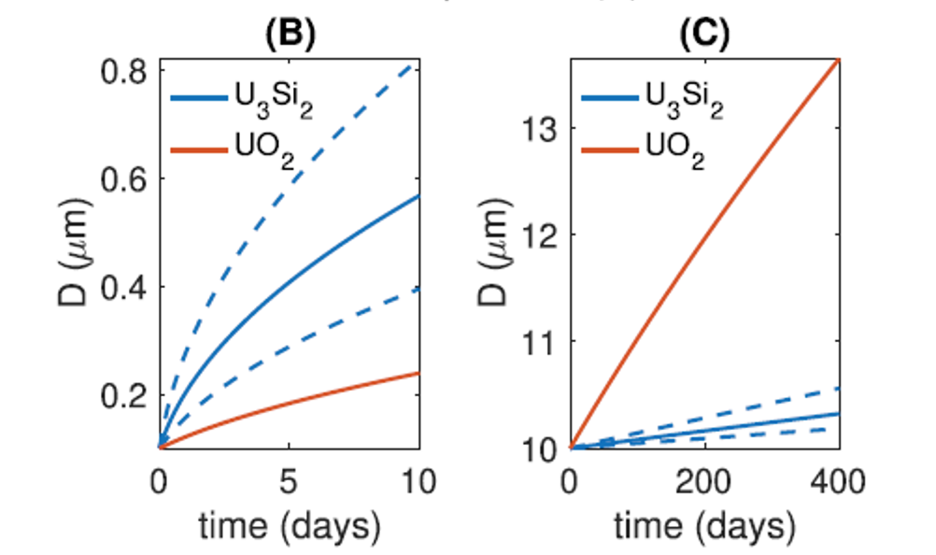
Comparison with UO₂

Slide 22
Conclusion and future work
Conclusion
Developed a model for normal grain growth in U₃Si₂
Average grain boundary energy obtained from creating a fit to temperature of values calculated using MD simulation
Activation energy estimated by comparing model predictions with the measured values
Shape factor determined using 3D phase field grain growth simulation
Future work
The resistive pressure should be considered
Other drive force can be considered
More data from simulations and experiments should be used

Slide 23
Thank you!

